Slide 1


Computational Reproducibility Tests of
Vanessa Rettkowski’s (2025) Findings
发表期刊：Collabra：Psychology
小组成员：方婧欣、王嘉秣、毛楠
汇报日期：2025.6.18
Rettkowski, V., Ingendahl, M., & Zeelenberg, M. (2025). How greedy people respond to missing discounts: Insatiability and inaction inertia. Collabra Psychology, 11(1), 133273. https://doi.org/10.1525/collabra.133273
Notes:
大家好，我们组复现的文献是2025年发表在 Collabra: Psychology 上的一篇研究，题目是《贪婪的人如何应对错过的折扣：不知足与不作为惰性》。

Slide 2
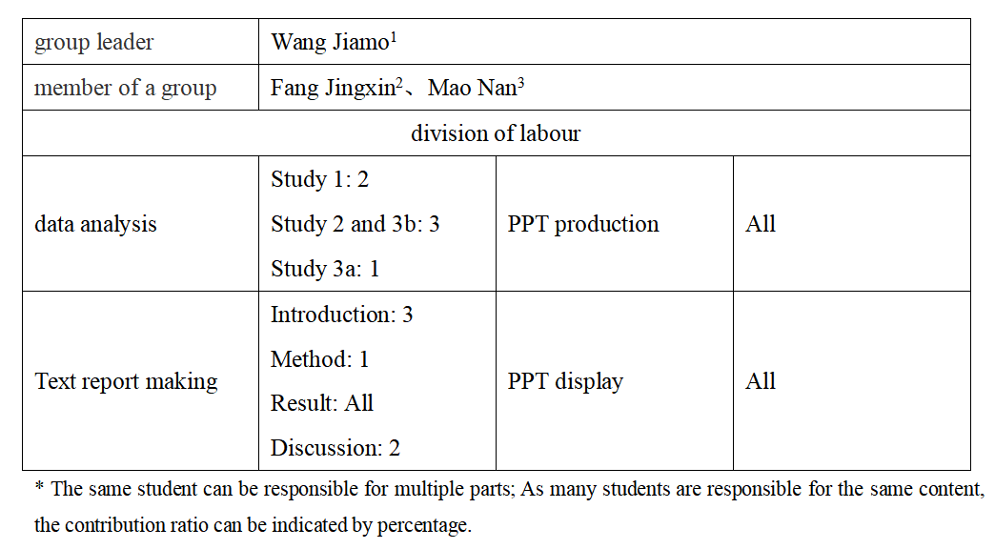
Group Roles

Slide 3
Introduction
Methods
Repeatability Results & Discussion
CONTENTS

Slide 4
Introduction
Part 1

Slide 5



Introduction
Methods
Results & Discussion
Part one
Part two
Part three
Missing a discount could lead to inaction inertia:
the phenomenon that “bypassing an initial action opportunity decreases the likelihood that subsequent similar action opportunities will be taken”(Tykocinski et al., 1995).
不作为惯性：当人们错过一个很大的折扣后，再面对一个小的折扣时，会更不愿意行动。
$40
Missed discount
$100
Original price
$90
Present discount

Slide 6
Introduction
Methods
Results & Discussion
Part one
Part two
Part three
Greed is excessive, as greedy people want more than they need – as much as possible and as good as possible of any desirable thing. Greed is not restricted to money. It includes non-monetary goods and intangible experiences, such as power, status, and the number of sexual partners.
Chosen fot two reasons:
First, it may help us to understand who is affected most by missing discounts and, thus, most likely to suffer from inaction inertia.
Second, it may also teach us more about what greed is and what greed does.
Ha: Greedy people always want more——builds on the finding that greed is mostly excessive acquisitiveness.
Hb: Greedy people hate losing——assumes that greedy people are stingy, valuemoney more, and show more loss aversion.

Slide 7
Methods
Part 2

Slide 8
Introduction
Methods
Results & Discussion
Part one
Part two
Part three
Dispositional Greed Scale (DGS)
A 7-item self-report scale assessing individual differences in greed (Seuntjens et al., 2015).
Inaction Inertia Scenarios:
A set of decision-making scenarios adapted from previous research:
Ski Pass, Car, Fitness Club (Tykocinski et al., 1995).
Couch (Zeelenberg et al., 2006).
City Trip (adapted from Zeelenberg et al., 2006).
Retirement Saving (Krijnen et al., 2019).
Each participant saw a subset of scenarios (within- or between-subjects).
Each scenario included:
Purchase intention: “How likely would you be to purchase?”.
Valuation: “How valuable is this offer?” .
Notes:
1. Dispositional Greed Scale (DGS) — 贪婪倾向量表
7条题目，衡量个体贪婪差异 (Seuntjens et al., 2015)
Inaction Inertia Scenarios — 不作为惰性情境 选用多个经典情境，保证效应的可复现性（参考 Chen et al., 2021）
滑雪通行证、汽车、健身俱乐部（Tykocinski et al., 1995）
沙发（Zeelenberg et al., 2006）
城市旅游（改编，Zeelenberg et al., 2006）
退休储蓄（Krijnen et al., 2019）
每个情境单独呈现，包含以下测量：
购买可能性（0 = 绝不会，10 = 一定会）
价值评估（0 = 一点价值没有，10 = 非常有价值）
Greed, purchase likelihood, and valuation贪婪、购买可能性、估值

Slide 9
Introduction
Methods
Results & Discussion
Part one
Part two
Part three
The original paper includes:
Study 1: 551 participants completed six inaction inertia scenarios (3 small vs. 3 large value differences) in a within-subjects design. Order of greed assessment and scenarios was counterbalanced.
Study 2: 1100 participants completed in a between-subjects design with two value difference conditions (small vs. large) using a single fitness club scenario
Study 3:
Study 3a – Replicated Study 1’s within-subjects design (4 scenarios) to test robustness (545 participants).
Study 3b – Replicated Study 2’s single-scenario design (car scenario) to conceptually replicate findings and reduce cost (1100 participants).
Notes:
三个研究均探讨了估值（小 vs. 大）和个体贪婪倾向对不作为惰性的影响。研究1采用了被试内设计，让参与者依次完成多个不同情境的任务；研究2采用了被试间设计，仅包含单一情境以简化程序；研究3结合了两者，测试鲁棒性（test robustness）。3a部分重复了研究1的被试内设计但减少了情境数量，3b部分则复制了研究2的被试间单情境设计。所有研究均通过Prolific Academic在线招募以英语为母语的参与者完成，且研究3a的参与者同时贡献了3b的数据，实现了对前两项研究的近似直接和概念性重复。

Slide 10
Introduction
Methods
Results & Discussion
Part one
Part two
Part three
Statistical analysis method:
Moderated mediation analysis —— bruceR package
Mixed-Effects Model Analysis —— lme4 package
Linear Model —— base R package
Multilevel SEM —— lavaan package
Analyses were conducted using R (version 4.4.2 / 4.4.3).

Slide 11
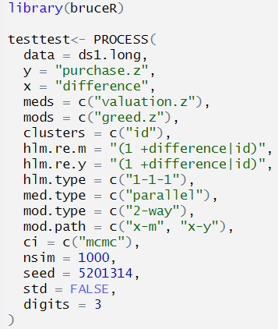
Introduction
Methods
Results & Discussion
Part one
Part two
Part three
Study 1 —— Moderated mediation analysis
bruceR is an R package for easy multilevel moderated mediation analysis, inspired by dplyr for clean data manipulation, supporting Bayesian confidence intervals with MCMC.
The process() function is used in R to simplify the analysis of moderation, mediation, and moderated mediation effects.
Table 1 Parameters in bruceR
Parameter | Meaning
data | The dataset you use for analysis
y | Outcome variable (dependent variable)
x | Predictor variable (independent variable)
meds | Mediator variable(s)
mods | Moderator variable(s)
clusters | Grouping variable for nested data (e.g., subject ID)
hlm.re.m | Random effects structure for the mediator model
hlm.re.y | Random effects structure for the outcome model
hlm.type | Levels of variables in multilevel model (e.g., "1-1-1")
Fig 1 Code for multilevel moderated mediation
Notes:
bruceR 是一个为行为科学研究设计的 R 包，提供一站式统计分析功能。
它集成了常用分析方法（如中介、调节、回归、多层模型），语法简洁，便于快速建模与结果输出。在这个研究中，用于多层调节中介模型。
bruceR 包中的 process() 函数，是用于在 R 中简化 调节效应（moderation）、中介效应（mediation） 以及 调节中介效应（moderated mediation） 分析的函数，灵感来源于 Andrew Hayes 的 SPSS/Macro 工具 PROCESS。
参数名 含义与功能
data 输入的数据框（data frame），必须包含所有变量及聚类标识符。
y 因变量（dependent variable）的列名字符串，例如 "purchase.z"。
x 自变量（independent variable）的列名字符串，例如 "difference"。
meds 中介变量（mediators）的列名向量，支持一个或多个中介变量，例如 c("valuation.z")。
mods 调节变量（moderators）的列名向量，支持多个调节变量，例如 c("greed.z")。
clusters 聚类变量（cluster ID）的列名向量，定义数据的多层次结构，如 c("id")，表示按个体id聚类。
hlm.re.m 中介模型中的随机效应结构，写法与 lme4 包的随机效应公式相同，如 `"(1 + difference
hlm.re.y 因变量模型的随机效应结构，类似上面，用于指定因变量模型中的随机截距和斜率。
hlm.type 多层次模型的类型，格式为 "1-1-1" 等，表示自变量-中介-因变量的层次，数字代表变量所在层次。

Slide 12
Introduction
Methods
Results & Discussion
Part one
Part two
Part three
Study 1 —— Moderated mediation analysis
bruceR is an R package for easy multilevel moderated mediation analysis, inspired by dplyr for clean data manipulation, supporting Bayesian confidence intervals with MCMC.
The process() function is used in R to simplify the analysis of moderation, mediation, and moderated mediation effects.
Table 1 Parameters in bruceR
Parameter | Meaning
med.type | Type of mediation ("parallel" means mediators are separate)
mod.type | Type of moderation (e.g., "2-way" for two variables)
mod.path | Which paths are moderated (e.g., "x-m", "x-y")
ci | Method for confidence intervals ("mcmc" uses Bayesian simulation)
nsim | Number of simulations for confidence intervals
seed | Random seed for reproducible results
std | Whether to standardize variables before analysis
digits | Number of decimal places in output
Fig 1 Code for multilevel moderated mediation
Notes:
med.type 中介变量类型，常用 "parallel" 表示多个中介变量之间平行，不存在顺序中介关系。
mod.type 调节类型，"2-way"表示两个变量之间的调节效应，支持 "2-way" 或 "3-way" 等。
mod.path 指定调节作用发生在哪些路径上，常用路径包括 "x-m"（自变量到中介的路径）、"x-y"（自变量到因变量路径）等。
ci 置信区间计算方法，"mcmc" 表示使用贝叶斯马尔科夫链蒙特卡洛模拟（可更准确地估计不对称置信区间）。
nsim 置信区间模拟次数，如 1000 次 MCMC 模拟，提高估计的稳定性。
seed 随机数种子，确保结果可复现。
std 是否对变量进行标准化，FALSE表示不标准化，TRUE表示自动标准化所有变量。
digits 结果显示的小数点位数，便于结果汇报。

Slide 13
Introduction
Methods
Results & Discussion
Part one
Part two
Part three
Study 1 —— Mixed-Effects Model Analysis:
lme4 (Bates et al., 2015) is an R package used to fit linear and generalized linear mixed-effects models for clustered or repeated-measures data.
Independent variable: two main effects + one interaction effect.
Dependent variable
random effects
dataframe
Fig 2 Code for linear mixed-effects model
Notes:
这是一个线性混合效应模型（Linear Mixed-Effects Model），使用 lme4 包中的 lmer() 函数进行拟合。
模型考察了 价值差异 × 贪婪程度 对购买意愿（purchase.1）的影响。【具体来说：这个模型用评价分数（valuation.1）作为因变量，预测变量包括价值差异（difference.str）、贪婪（greed.z），以及它们的交互作用，同时允许每个参与者（id）在价值差异的影响上有不同的随机截距和斜率。】
(difference.str | id) 表示对 id 加入随机斜率和截距，换句话说，模型允许“价值差异对评价的影响”在不同个体之间有所不同，不是全体统一一个效应。

Slide 14
Introduction
Methods
Results & Discussion
Part one
Part two
Part three
Study 2 —— Linear Regression Model
The lm() function in base R is used to fit linear regression models. It estimates the relationship between a continuous outcome variable and one or more predictors (independent variables).
Fig 3 Code for linear mixed-effects model
Notes:
Study 2 是 between-subjects（组间设计），因为每位参与者只暴露于一种价值差异情境中，这与 Study 1 的 within-subjects（组内设计）不同，因此分析方法也更简单，采用普通线性回归即可。
这段代码运行了一个线性回归模型，预测标准化的购买意愿（purchase.between.z），自变量包括贪婪水平（greed.z）、价值差异条件（difference.between）及其交互作用。

Slide 15
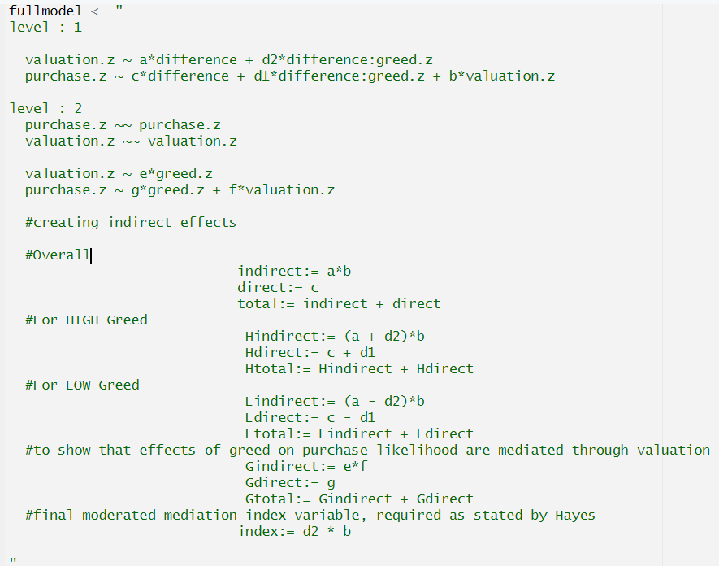
Introduction
Methods
Results & Discussion
Part one
Part two
Part three
Study 3 —— Multilevel SEM:
lavaan (Rosseel, 2012) is an R package used to specify and estimate structural equation models (SEMs), including path analysis, confirmatory factor analysis (CFA), and latent variable models. In the present study, lavaan was used to conduct a multilevel moderated mediation analysis.
The sem() function is used to fit structural equation models (SEMs), which allow researchers to examine complex relationships between observed and/or latent variables.
Table 2 Parameters in Level 1
Model Path | Type of Effect | Interpretation
valuation.z ~ a*difference | Main effect | Within-person effect of value difference on subjective valuation.
valuation.z ~ d2*difference:greed.z | Interaction effect | Moderation effect of greed on the value difference → valuation path.
purchase.z ~ c*difference | Main effect | Within-person effect of value difference on purchase intention.
purchase.z ~ d1*difference:greed.z | Interaction effect | Moderation effect of greed on the value difference → purchase path.
purchase.z ~ b*valuation.z | Mediation path (b path) | Effect of valuation on purchase intention (mediating the value difference effect).
Fig 4 Code for Multilevel SEM
Notes:
lavaan 是 latent variable analysis 的缩写，是 R 中用于 结构方程模型（SEM） 的主要包之一。它支持：路径分析、确认性因子分析（CFA）\多层结构模型（Multilevel SEM）\中介/调节/调节中介模型\以及模型拟合评估和参数估计
sem() 用于拟合结构方程模型（SEM），包括路径分析（Path analysis）中介模型（Mediation models）调节模型（Moderation models）多层模型（Multilevel models）潜变量模型（Latent variable models）（如果你用 latent =~ 的话）
路径 含义
valuation.z ~ a*difference 主效应：价值差异（value difference）对主观估值的影响（a路径）
+ d2*difference:greed.z 交互效应：价值差异与贪婪的交互对估值的调节作用（调节中介的起点路径）
purchase.z ~ c*difference 主效应：价值差异对购买意愿的直接影响（c路径）
+ d1*difference:greed.z 交互效应：价值差异与贪婪的交互对购买意愿的调节作用
+ b*valuation.z 中介路径：估值对购买意愿的影响（b路径）

Slide 16
Introduction
Methods
Results & Discussion
Part one
Part two
Part three
Study 3 —— Multilevel SEM:
lavaan (Rosseel, 2012)
The sem() function
Table 3 Parameters in Level 2
Model Path | Type of Effect | Interpretation
purchase.z ~~ purchase.z | Random intercept variance | Between-person variance in purchase intention.
valuation.z ~~ valuation.z | Random intercept variance | Between-person variance in subjective valuation.
valuation.z ~ e*greed.z | Main effect | Between-person effect of greed on subjective valuation.
purchase.z ~ g*greed.z | Main effect | Between-person effect of greed on purchase intention.
purchase.z ~ f*valuation.z | Mediation path (Level 2 b path) | Between-person effect of subjective valuation on purchase intention.
Fig 4 Code for Multilevel SEM
Notes:
purchase.z ~~ purchase.z
表示：在 Level 2 层级中，模型估计 购买意愿（purchase.z）在个体间的方差。
翻译：估计个体之间的购买意愿的变异性。
举例：有些人总是更倾向购买，而有些人则普遍不愿意买。这种“人和人之间的平均差异”就是 Level 2 的变异。
✅ valuation.z ~~ valuation.z
表示：在 Level 2 层级中，模型估计 主观估值（valuation.z）在个体间的方差。
翻译：估计个体之间主观估值的变异性。
举例：有的人总体上会认为所有东西都很有价值，有些人则很理性或吝啬，这种个体间的稳定差异也是 Level 2 的变异。
路径 含义
valuation.z ~ e*greed.z 主效应（Level 2）：贪婪对估值的个体间影响
purchase.z ~ g*greed.z 主效应（Level 2）：贪婪对购买意愿的个体间影响
+ f*valuation.z 中介路径（Level 2）：估值对购买意愿的影响（b路径在Level 2）

Slide 17
Introduction
Methods
Results & Discussion
Part one
Part two
Part three
Study 3 —— Multilevel SEM:
lavaan (Rosseel, 2012)
The sem() function
Table 4 moderated mediation index
Model Path | Type of Effect | Interpretation
index := d2*b | Moderated mediation index | Does greed moderate the indirect effect of value difference on purchase intention via valuation?
Model
Fig 8 Code for Multilevel SEM (full model)
Fig 4 Code for Multilevel SEM
Notes:
level2 是属于greed自己的中介模型
调节中介指数（moderated mediation index），即 d2（调节作用）× b（中介路径）;若此 index 显著，说明贪婪调节了中介路径（即贪婪是否显著影响“价值差异 → 估值 → 购买意愿”）

Slide 18
Part 3
Repeatability Results & Discussion

Slide 19
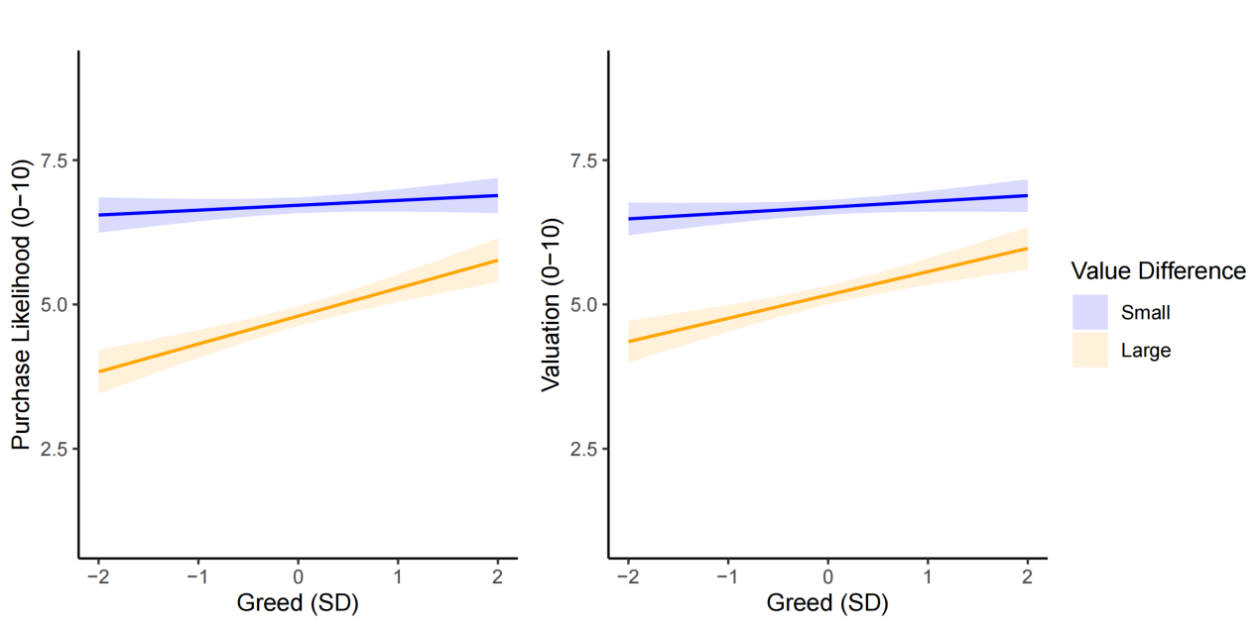
Introduction
Methods
Results & Discussion
Part one
Part two
Part three
Study 1: Purchase Likelihood & Valuation
Random intercepts were modeled at the participant level. Greed, purchase likelihood, and valuation were z-standardized at the grand mean (left panel Figure 10).
To further test the mediating role of valuation in inaction inertia, study 1 repeated the same analyses on the mediator valuation as the dependent variable (right panel Figure 10).
Figure 10 Reproducibility results of effects of greed and value difference on purchase likelihood and valuation
Notes:
在参与者层级建模随机截距。贪婪、购买可能性和估值以总均值为基准进行z分数标准化，主要结果见图10左面板。
为检验估值在不作为惯性中的中介作用，以估值为因变量重复相同分析（图10右面板）。

Slide 20
Introduction
Methods
Results & Discussion
Part one
Part two
Part three
Table 5 Replication of the Inaction Inertia Effect on Purchase Likelihood
 |  | b | z | 95%CI | p
purchase.z ~ differenc | original | 0.70 | 23.23 | [0.64, 0.76] | < 0.001
 | this | 0.70 | 23.23 | [0.64, 0.76] | < 0.001
 | δ | 0% | 0% | 0% | 0%
 | rating | consistent | consistent | consistent | consistent
purchase.z ~ greed.z | original | 0.10 | 3.93 | [0.05, 0.16] | < 0.001
 | this | 0.10 | 3.94 | [0.05, 0.16] | < 0.001
 | δ | 0% | 0.25% | 0% | 0%
 | rating | consistent | slight deviation | consistent | consistent
purchase.z ~ dffrnc:g. | original | -0.15 | -4.60 | [-0.21, -0.08] | < 0.001
 | this | -0.15 | -4.60 | [-0.21, -0.08] | < 0.001
 | δ | 0% | 0% | 0% | 0%
 | rating | consistent | consistent | consistent | consistent
Notes:
价值差异的主效应：当价值差异较小时（vs 较大时），参与者的购买可能性显著更高，复现了不作为惯性效应。
贪婪的主效应：贪婪个体整体购买可能性更高。
贪婪的调节作用：贪婪削弱了价值差异对购买可能性的影响，贪婪水平越高，该效应显著减弱。

Slide 21
Introduction
Methods
Results & Discussion
Part one
Part two
Part three
Table 6 Replication of the Inaction Inertia Effect on Valuation
 |  | b | z | 95%CI | p
valuation.z ~ differenc | original | 0.61 | 19.99 | [0.55, 0.67] | < 0.001
 | this | 0.61 | 19.99 | [0.55, 0.67] | < 0.001
 | δ | 0% | 0% | 0% | 0%
 | rating | consistent | consistent | consistent | consistent
valuation.z ~ greed.z | original | 0.10 | 3.62 | [0.05, 0.16] | < 0.001
 | this | 0.10 | 3.62 | [0.05, 0.16] | < 0.001
 | δ | 0% | 0% | 0% | 0%
 | rating | consistent | consistent | consistent | consistent
valuation.z ~ dffrnc:g. | original | -0.12 | -3.85 | [-0.18, -0.06] | < 0.001
 | this | -0.12 | -3.85 | [-0.18, -0.06] | < 0.001
 | δ | 0% | 0% | 0% | 0%
 | rating | consistent | consistent | consistent | consistent
Notes:
价值差异的主效应：价值差异较小（vs.较大）时，参与者对商品的估值显著更高。
贪婪的主效应：贪婪个体整体估值更高。
贪婪的调节作用：贪婪同样削弱价值差异对估值的影响，贪婪水平越高，该效应显著减弱。

Slide 22
Introduction
Methods
Results & Discussion
Part one
Part two
Part three
Study 1: Moderated Mediation Analysis
The inaction inertia effect was mediated by valuation.
Table 7 Replication of the Mediation Analysis
 |  | b | z | 95%CI | p
indirect | original | 0.39 | 16.63 | [0.35, 0.44] | < 0.001
 | this | 0.39 | 16.63 | [0.35, 0.44] | < 0.001
 | δ | 0% | 0% | 0% | 0%
 | rating | consistent | consistent | consistent | consistent
direct | original | 0.31 | 11.54 | [0.25, 0.36] | < 0.001
 | this | 0.31 | 11.55 | [0.25, 0.36] | < 0.001
 | δ | 0% | 0.09% | 0% | 0%
 | rating | consistent | slight deviation | consistent | consistent
Notes:
估值的中介作用（间接效应）：价值差异 → 估值 → 购买可能性的间接效应显著；不作为惯性效应通过估值中介，间接效应显著。
部分中介（直接效应仍显著）：即使控制估值的中介作用，价值差异仍直接影响购买意愿。

Slide 23
Introduction
Methods
Results & Discussion
Part one
Part two
Part three
Table 8 Replication of the Moderated Mediation Analysis
 |  | b | z | 95%CI | p
index | original | -0.08 | -3.85 | [-0.12, -0.04] | < 0.001
 | this | -0.08 | -3.85 | [-0.12, -0.04] | < 0.001
 | δ | 0% | 0% | 0% | 0%
 | rating | consistent | consistent | consistent | consistent
purchase.z ~ dffrnc:g. | original | -0.07 | -3.07 | [-0.11, -0.02] | 0.002
 | this | -0.07 | -3.08 | [-0.11, -0.02] | 0.002
 | δ | 0% | 0.32% | 0% | 0%
 | rating | consistent | slight deviation | consistent | consistent
Gindirect | original | 0.07 | 3.60 | [0.03, 0.11] | < 0.001
 | this | 0.07 | 3.60 | [0.03, 0.11] | < 0.001
 | δ | 0% | 0% | 0% | 0%
 | rating | consistent | consistent | consistent | consistent
Gdirect | original | 0.03 | 1.84 | [-0.00, 0.07] | 0.067
 | this | 0.03 | 1.84 | [-0.00, 0.07] | 0.067
 | δ | 0% | 0% | 0% | 0%
 | rating | consistent | consistent | consistent | consistent
Notes:
有调节的中介指数：贪婪特质显著调节了"价值差异→估值→购买意愿"的中介路径。
直接效应的调节作用：贪婪同样调节价值差异对购买意愿的直接作用（不通过估值的路径）。
贪婪影响购买意愿的双路径：
间接路径（完全中介）：贪婪 → 提升估值 → 增加购买意愿
直接路径（不显著）：贪婪 → 购买意愿的直接作用不显著

Slide 24
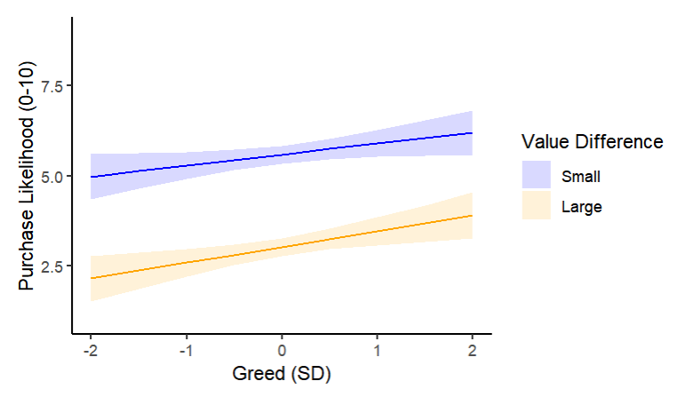
Introduction
Methods
Results & Discussion
Part one
Part two
Part three
Study 2: Purchase Likelihood
Study 2 calculated a linear regression analysis in which z-standardized purchase likelihood was predicted by the interaction between z-standardized greed and value difference.
Figure 11 Reproducibility results of effects of Greed and Value Difference on Purchase Likelihood in Study 2

Slide 25
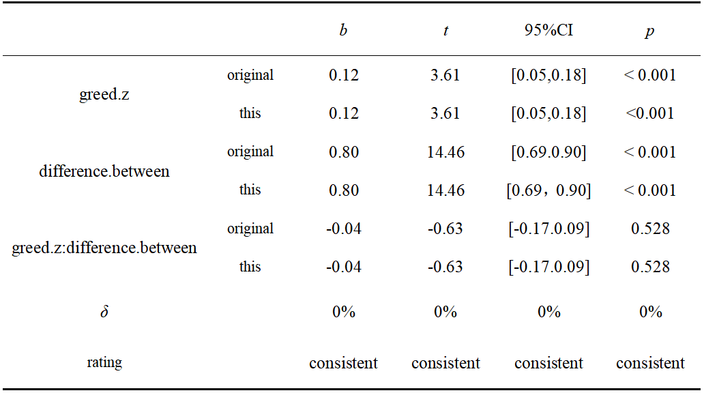
Introduction
Methods
Results & Discussion
Part one
Part two
Part three
Table 9 Replication of the mediation analysis of study 2
Notes:
贪婪的主效应 价值差异的主效应（不作为惯性效应） 贪婪的调节作用（交互作用）不显著

Slide 26
Introduction
Methods
Results & Discussion
Part one
Part two
Part three
Study 3a (Within-Subjects): Purchase Likelihood
Table 10 Replication of the Inaction Inertia Effect on Purchase Likelihood
 |  | b | z | 95%CI | p
greed.z | original | 0.07 | 2.75 | [0.02, 0.12] | 0.006
 | this | 0.07 | 2.75 | [0.02,0.12] | 0.006
 | δ | 0% | 0% | 0% | 0%
 | rating | consistent | consistent | consistent | consistent
difference | original | 0.71 | 19.28 | [0.64, 0.79] | < 0.001
 | this | 0.71 | 19.28 | [0.64, 0.79] | < 0.001
 | δ | 0% | 0% | 0% | 0%
 | rating | consistent | consistent | consistent | consistent
difference:greed.z | original | -0.02 | -0.59 | [-0.10, 0.05] | 0.557
 | this | -0.02 | -0.57 | [-0.10, 0.055] | 0.572
 | δ | 0% | 3.5% | / | 2.6%
 | rating | consistent | slight deviation | rounding deviation | slight deviation
Notes:
贪婪水平有主效应：贪婪越高，购买意愿越高。
价值差异的主效应：复现了“不作为惯性效应”，小价值差异组比大价值差异组购买意愿高。
效应不受“贪婪”程度调节：这里的调节作用不显著。

Slide 27
Introduction
Methods
Results & Discussion
Part one
Part two
Part three
Study 3a (Within-Subjects): Effect on Valuation
Table 11 Replication of the Inaction Inertia Effect on Valuation
 |  | b | z | 95%CI | p
greed.z | original | 0.10 | 3.64 | [0.05, 0.16] | < 0.001
 | this | 0.10 | 3.64 | [0.05,0.16] | < 0.001
 | δ | 0% | 0% | 0% | 0%
 | rating | consistent | consistent | consistent | consistent
difference | original | 0.63 | 17.02 | [0.56, 0.70] | < 0.001
 | this | 0.63 | 17.02 | [0.56,0.70] | < 0.001
 | δ | 0% | 0% | 0% | 0%
 | rating | consistent | consistent | consistent | consistent
difference:greed.z | original | -0.02 | -0.57 | [-0.10, 0.06] | 0.572
 | this | -0.02 | -0.57 | [-0.10, 0.06] | 0.572
 | δ | 0% | 0% | 0% | 0%
 | rating | consistent | consistent | consistent | consistent
Notes:
贪婪的主效应：高贪婪者普遍给出更高估值。
价值差异效应：当错过的折扣较小时，对当前折扣的估值显著更高。这表明价值差异对估值有显著影响。
贪婪的调节作用（不显著）：贪婪不能改变价值差异对估值的影响。

Slide 28
Introduction
Methods
Results & Discussion
Part one
Part two
Part three
Study 3a (Within-Subjects): Moderated Mediation Analysis
No significant moderated mediation found.
Table 12 Replication of the Moderated Mediation Analysis
 |  | b | z | 95%CI | p
index | original | -0.02 | -0.57 | [-0.08, 0.04] | 0.572
 | this | -0.02 | -0.57 | [-0.08, 0.04] | 0.572
 | δ | 0% | 0% | 0% | 0%
 | rating | consistent | consistent | consistent | consistent
Notes:
有调节的中介分析：贪婪不能调节"价值差异→估值→购买意愿"的中介路径。
总结（包含前两页一起的总结）：价值差异通过估值影响购买可能性，估值起中介作用。贪婪虽显著影响估值和购买，但未调节价值差异的影响，调节中介效应不存在。】
只报告了最后的Moderated Mediation Index 值，复现结果和正文一致。

Slide 29
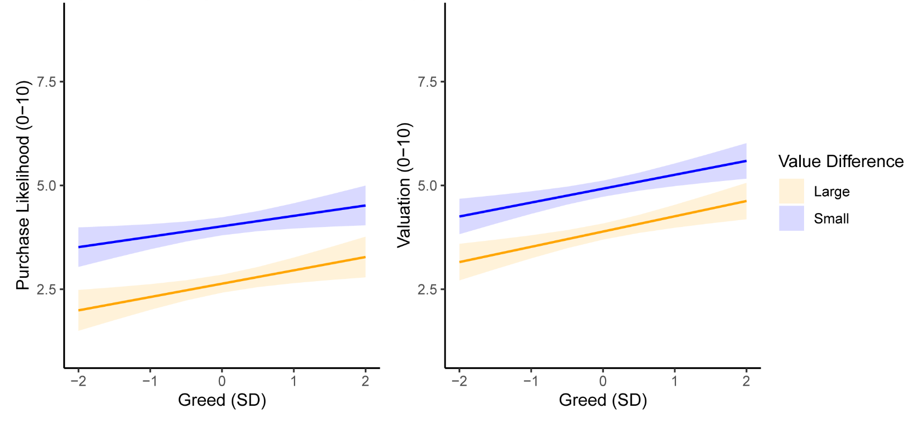
Introduction
Methods
Results & Discussion
Part one
Part two
Part three
Study 3b (Between-Subjects): Purchase Likelihood and Valuation
Figure 12 Reproducibility results of effects of Greed and Value Difference on Purchase Likelihood in Study 3b

Slide 30
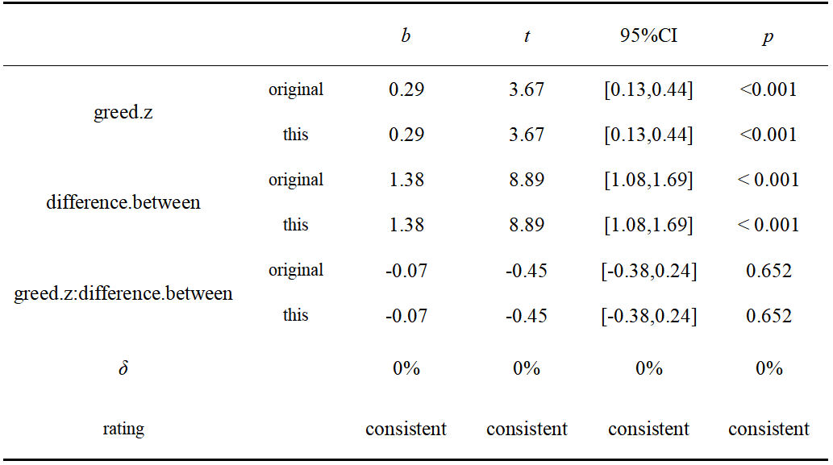
Introduction
Methods
Results & Discussion
Part one
Part two
Part three
Table 13 Replication of the mediation analysis of study 3b
Notes:
贪婪的主效应（稳定模式）：高贪婪者始终表现出更强的购买倾向
价值差异的主效应、不作为惯性效应（核心发现）：当参与者错过的是小折扣（价值差异小）时，购买意愿显著更高
交互作用不显著（关键矛盾点）：贪婪不能改变价值差异对购买意愿的影响

Slide 31
Introduction
Methods
Results & Discussion
Part one
Part two
Part three
Four: might be due to the error caused by rounding.
The other two: might be due to the inherent small computational errors in the model estimation.
Table 14 Evaluation table for reproducibility of all data calculations
repeatability | quantity(N) | proportion(%)
consistent (δ = 0%) | 94 | 94
slight deviation (0% < δ < 10%) | 6 | 6
large deviation (δ ＞ 10%) | 0 | 0
rounding deviation | 4 | 4

Slide 32
Introduction
Methods
Results & Discussion
Part one
Part two
Part three
The inferences fully replicated the results of the original study.
Table 15 Consistency Evaluation Table of Inferences (Original Analysis Method)
inference consistency | quantity and proportion
 | N* | %
consistent | 25 | 100
inconsistent | 0 | 0

Slide 33
Introduction
Methods
Results & Discussion
Part one
Part two
Part three
Apart from these minor inconsistencies mentioned above, we have perfectly reproduced all the other results of this study. The reasons for the successful reproducibility may be as follows.
The article provides complete data and code files. The data files are further divided into the original data files and those specifically designed for R analysis. The code files contain simple annotations for each step of the operation, enabling us to understand and reproduce each step of the research very well.
Most of the analyses in this paper do not involve calculation codes such as setting random numbers for fixed seeds that may cause minor random errors. This also makes most of our reproduction results completely consistent with the original study.

Slide 34
THANKS!

